Slide 1

WellBot
AI-Powered Wellness Chatbot Platform
Intelligent healthcare assistance with hybrid AI and real-time analytics for personalized wellness guidance

Slide 2

Team Members
Sameer: Gained understanding of end-to-end client–server architecture integrating Flask APIs, WebSockets, and API Keys
Tejaswini: Developed hands-on expertise in building NLP pipelines from tokenization to intent classification.
Apeksha: Learned to implement secure authentication using bcrypt and JWT, emphasizing security-first design.
Avinash Patil: Explored responsible deployment of LLMs in healthcare using OpenAI GPT and prompt engineering.
Sakshi: Built strong foundations in SQL database design and multi-user session management.
Harika: Understood the importance of UI/UX in AI systems through frontend development and theming.

Slide 3
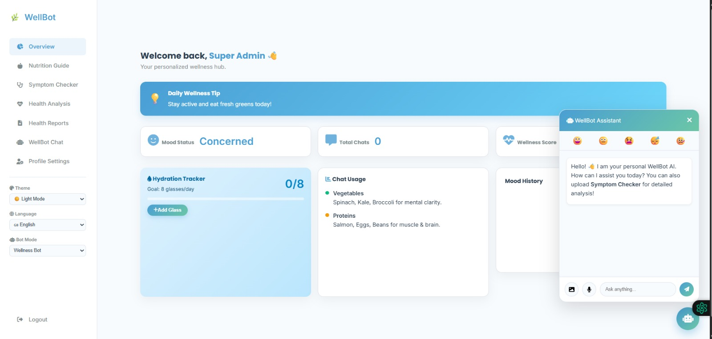
Platform Overview
WellBot combines conversational AI, health analytics, and wellness tracking into a unified platform. Using hybrid AI models, it delivers accurate responses while tracking health metrics like BMI, calories, sleep, and heart rate.
The platform is designed to be user-friendly, secure, and scalable for healthcare organizations.

Slide 4





Problem Statement
Current healthcare systems create barriers that prevent people from getting the quick, accessible guidance they need.
Prescription Confusion
Limited Access
Patients struggle to understand complex medication instructions and dosage requirements from handwritten or printed prescriptions.
Quick health advice is difficult to obtain outside regular office hours, leaving patients without immediate support during urgent moments.
No Centralized Platform
Tracking Gaps
Health information remains fragmented across multiple sources without an integrated AI-powered wellness hub.
Lack of personalized, continuous health tracking prevents users from monitoring wellness trends and making informed decisions.

Slide 5

Introducing WellBot
A complete digital healthcare assistant experience combining intelligent chatbot technology, prescription analysis, and real-time wellness monitoring.
AI wellness chatbot
Prescription image analysis
Symptom checker
Nutrition guidance
Admin monitoring system

Slide 6






Core Features
AI-Powered Chatbot
Prescription Image Analysis
Instant health guidance through natural language conversations with intelligent AI that understands medical context and provides accurate, helpful responses.
Upload prescription images and let AI automatically extract medication names, dosages, and instructions for easy understanding.
Symptom Checker
Nutrition Guidance
Describe symptoms and receive preliminary diagnosis support, helping users understand potential conditions and decide when to seek medical care.
Get personalized dietary recommendations based on health goals, conditions, and preferences to support overall wellness.
Secure Data Management
Multi-Language Support
End-to-end encryption and secure database storage protect sensitive health information with enterprise-grade security protocols.
Access wellness guidance in multiple languages, breaking down communication barriers for global users.

Slide 7

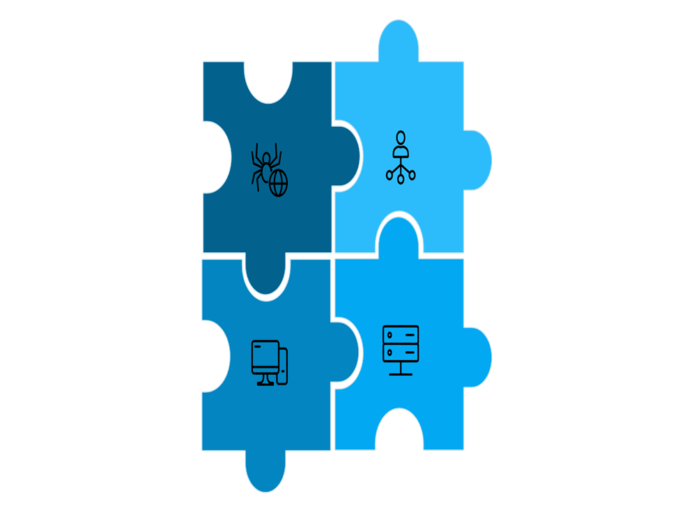
System Architecture
WellBot uses a hybrid AI architecture that routes requests to the most appropriate AI model based on query complexity and
requirements.
User Interface
Web and mobile frontend providing chat interface, dashboard, and image upload capabilities.
Frontend Dashboard
Interactive user experience with real-time updates, wellness tracking, and personalized content display.
Flask Backend API
RESTful API handles authentication, request routing, data validation, and response formatting.
AI Model Router
Intelligent routing system directs queries to Groq, Gemini, Ollama, or OpenAI based on requirements.
Database Storage
MongoDB stores user profiles, chat history, health data, and prescription analysis results securely.

Slide 8
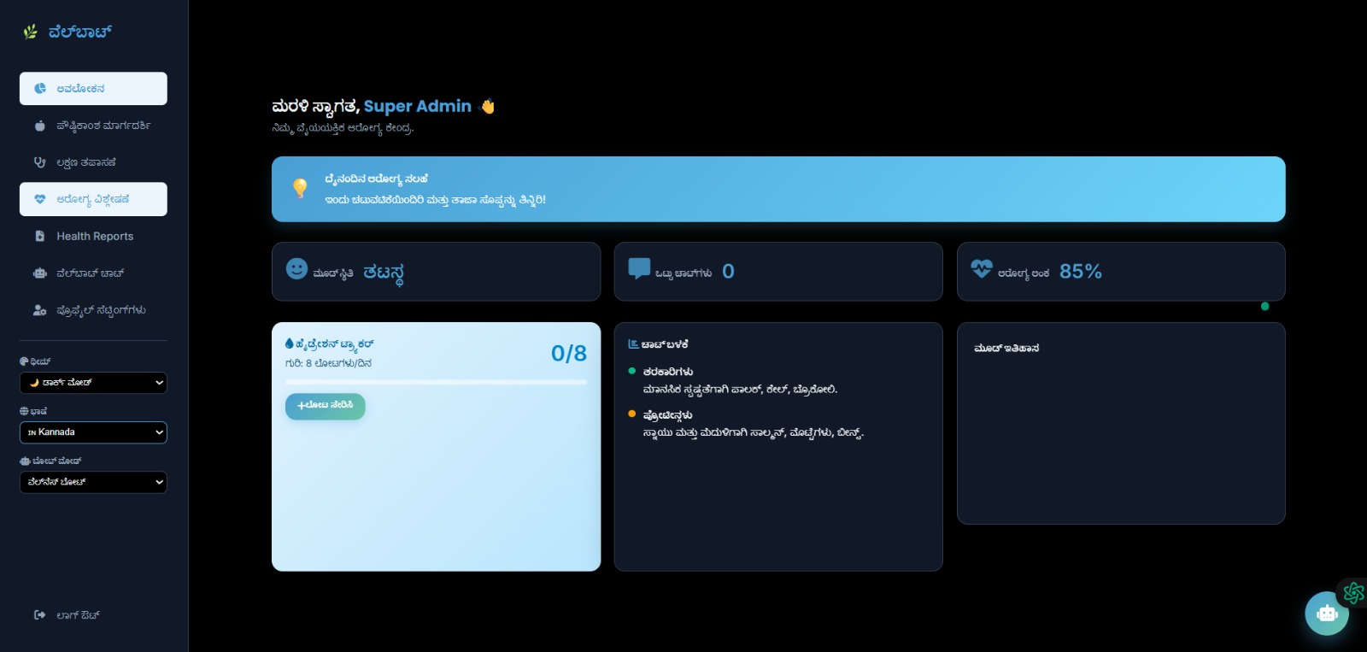
Multi-Language System 🌍
Global Accessibility
WellBot supports multiple languages to serve diverse user populations. Users can change the interface language with a single click, making healthcare assistance accessible to everyone regardless of their native language.
Currently Supported Languages
English - Primary interface language
Hindi - Serving Indian population
Kannada - Regional language support
Spanish - Global Spanish speakers
Additional languages can be added based on
market demand and user feedback.

Slide 9
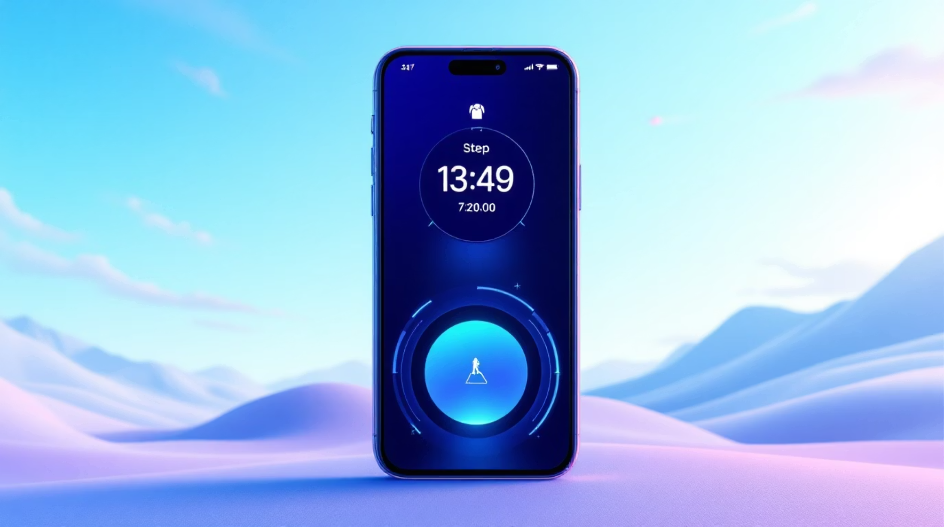
Real-Time Footprint Counter 👣
Activity Tracking Integration
The wellness dashboard includes a real-time footprint counter that displays the number of steps taken throughout the day.
How It Works
Connects to device sensors or fitness trackers
Updates step count in real time
Tracks daily activity goals
Displays weekly trends and patterns
Encourages healthy lifestyle choices through continuous activity monitoring and goal achievement notifications.

Slide 10
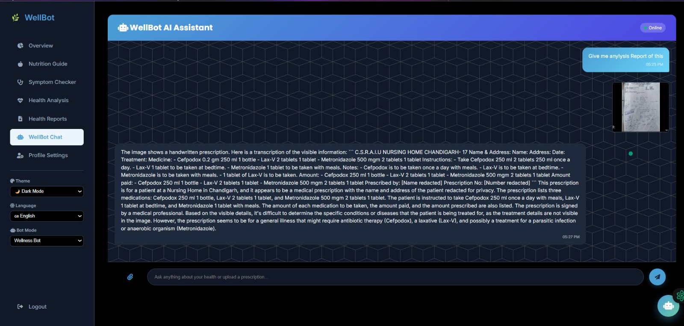
Theme System 🌙
Light Theme
Bright, clean interface optimized for daytime use with high contrast for readability in well-lit environments.
Dark Theme
Reduced eye strain during nighttime use with darker color palette that saves battery on OLED displays.
Users can switch between themes instantly, and the entire website background, text colors, and components update to match the selected theme.

Slide 11
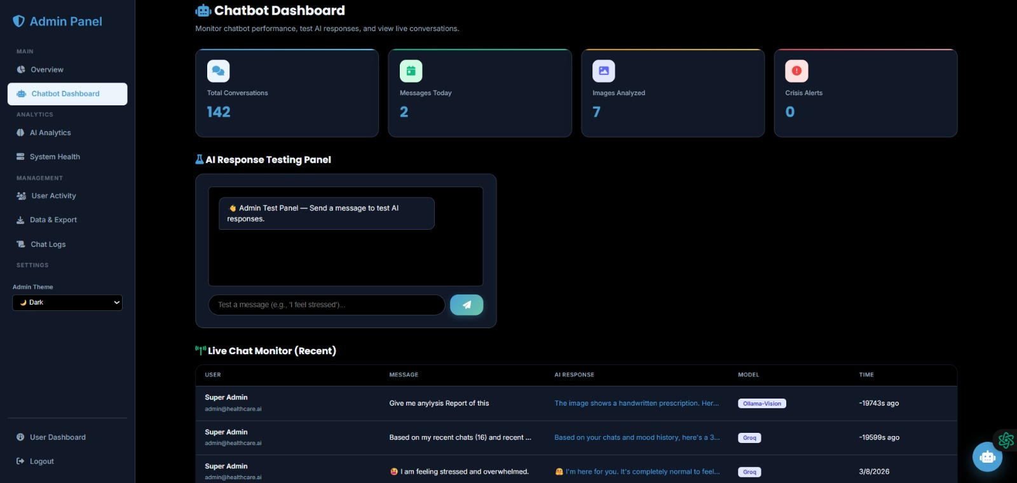





Admin Dashboard Capabilities
View A ll Users
Access complete user profiles, health data, and interaction history
Monitor Chat Logs
Review all conversations between users and the AI chatbot
View Reported Issues
System Statistics
Track AI Usage
Identify and address user-reported problems promptly
Monitor uptime, response times, and platform performance
Monitor AI model performance and response patterns

Slide 12



Admin Chatbot Features
Floating Chatbot Icon
Quick Chatbot Access
Instant AI Testing
Always-accessible chat interface on the admin dashboard for instant AI testing
Test chatbot responses without navigating away from the current admin page
Validate chatbot responses and AI accuracy in real-time before deployment
These admin page improvements allow administrators to test chatbot responses easily, ensuring accuracy and reliability before responses reach end users.

Slide 13
Impact & Benefits
⏱️ Saves Time
🏥 Reduces Physical Visits
Instant AI responses eliminate waiting periods and reduce administrative workload
Addresses minor health concerns remotely, reserving clinic visits for serious issues
📚 Improves Health Awareness
🌐 24/7 Accessible
Educational content and proactive alerts increase user health literacy
Available anytime, anywhere—users get support on-demand without time constraints
🧑‍🤝‍🧑 Global Support
📈 Promotes Prevention
Multi-language support enables serving users across different regions and time zones
Proactive monitoring and health tips encourage preventive care over reactive treatment

Slide 14
Advanced Health Monitoring
⚖️ BMI Calculator
🍎 Diet Recommendations
🔥 Calorie Tracker
Tracks body mass index and health status
Monitors daily calorie intake
Suggests personalized healthy meal plans
😴 Sleep Tracker
❤️ Heart Rate Monitor
Tracks sleep patterns and quality
Displays heart health data
These features help users maintain a balanced and healthy lifestyle through data-driven insights.

Slide 15
Future Development Roadmap
🧬 Wearable Integration
1
Connect with smartwatches and fitness bands for automatic health data synchronization
2
🧑‍⚕️ Doctor Consultations
Seamless integration with healthcare providers for video consultations and medical advice
📊 AI Health Prediction
3
Advanced predictive analytics using machine learning to identify potential health risks
4
🗣️ Voice Interaction
Voice-based chatbot for hands-free health assistance
📱 Mobile App
5
Dedicated iOS and Android apps for enhanced mobile experience
6
🧠 Personalized AI
Improved AI personalization using user data and behavior patterns

Slide 16

CONCLUSION
Making healthcare smarter, faster, and more accessible for everyone.
WellBot is an intelligent AI-powered healthcare assistant that combines chatbot, analytics, and health tracking in one platform. It uses hybrid AI models for accurate and efficient responses while remaining user-friendly, secure, and scalable.
Together, we're building a healthier future—one conversation at a time.

